Slide 1

HomeStays
Presented by
Pritam Shah Shyam Kharel
(14UCA014) (14UCA021)
Department of Computer Applications
School of Physical Sciences
Sikkim University

Slide 2
Table of Content
Abstract
Theoretical Framework
Literature Review
Methodology
Results
Conclusion and Future Work
References

Slide 3
HomeStays
Hospitality and Lodging | Local Residence
Is good business | Savings on lodging costs
Fights Loneliness | Information about the city

Slide 4
Objective
To provide a platform to Homestays of Sikkim.
To work to implement every possible Online payment option (excluding cryptocurrency).
Application will contain online pay option.
To provide location of homestays.

Slide 5
Objective
To provide all the features and offerings of homestays
To get the No. of days out of Date selected for staying and calculating Fare real-time.
To give the best UI design like others Hotel Booking apps

Slide 6

Problem Defintion
HomeStays- An Application

Slide 7
System Requirement
Hardware requirements
- Min 4GB RAM, 8GB(recommended).
- Min Intel i5 Core Processor.
Software requirements
- Android Studio 2.2.3
- Windows/Linux/ Mac OS
- Firebase Server.

Slide 8
Solution Strategy
Android Studio, Java, XML, Kotlin, PHP.
Use of Firebase Server
Implementing Payment Gateway
Appropriate Software Model.

Slide 9
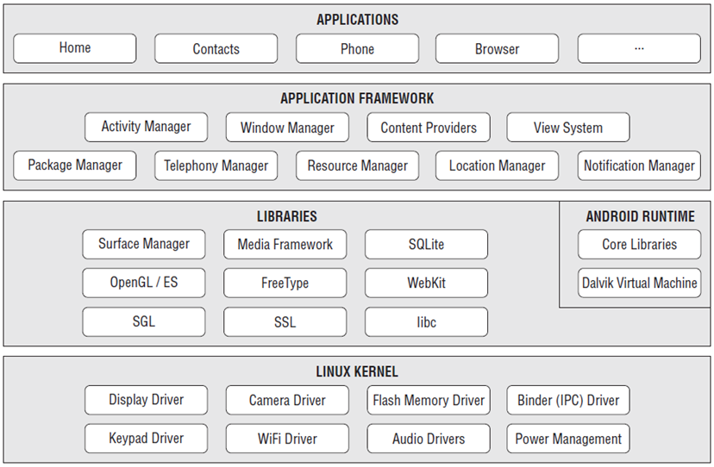
Android Architecture
Figure 1: Android Architecture [6]

Slide 10

DEVELOP
GROW
Backend Services
Real-time Database
Authentication
Hosting
Storage
Cloud Messaging
Remote Config
App Quality Services
Test Lab for Android
Crash Reporting
Dynamic Links
Invites
AdWords
Re-Engagement
Notifications
App Indexing
Analytics
EARN
In-app Ads
AdMob
Figure 2: Features of Firebase[1]

Slide 11

Solution Strategy

